Slide 1

MONTREAL RACE PREVIEW
Para Series Analysis · June 24 – 27, 2026
USA Triathlon High Performance

Slide 2
Race Week Schedule
Montreal
June 24 – 27, 2026 • Parc Jean-Drapeau, Notre-Dame Island, Montréal (EDT, UTC-4)
Thu • June 25
Fri • June 26
Sat • June 27
Open Training
Familiarization & Briefing
PARA RACE DAY
11:00 – 15:00 | Swim training — Aquatic Complex (50 m pool, 4 lanes)
14:00 – 17:00 | Gym training — Athletes' Quarter gym
(Wed Jun 24) | Pool training 14:00–18:00 + gym 14:00–17:00
07:45 | Departures from Host Hotel
08:45 – 09:15 | PTS/PTVI Bike Fam • PTWC Run Fam — Transition
09:30 – 10:00 | PTS/PTVI Run Fam • PTWC Bike Fam — Transition
10:15 – 11:00 | Swim Familiarisation (ALL) — Swim Start
10:15 – 10:45 | Coaches Onsite Meeting — Transition Area
10:30 – 12:00 | Equipment verification (ALL)
12:00 – 12:45 | ★ WTPS Pre-race briefing (ALL) — Athletes' Quarter
12:45 – 13:30 | Race Package Distribution
13:45 | Departures from venue
05:00 / 05:30 | Hotel departures — PTWC 05:00 • PTS/PTVI 05:30
05:30 / 06:15 | Athletes' Lounge opens — PTWC 05:30 • PTS/PTVI 06:15
06:15 – 06:45 | PTWC swim warm-up (on course) + transition check-in
06:53 | PTWC Athletes' Introduction
07:00 / 07:03 | ★ PTWC1 Men 07:00 • PTWC2 Men 07:03
07:04 / 07:08 | ★ PTWC1 Women 07:04 • PTWC2 Women 07:08
07:45 | ★ PTS5 Men start
07:50 / 07:53 | ★ PTVI1 Men 07:50 • PTVI2/3 Men 07:53
07:54 / 07:57 | ★ PTVI1 Women 07:54 • PTVI2/3 Women 07:57
08:10 / 08:15 | ★ PTS5 Women 08:10 • PTS2/3/4 Women 08:15
08:25 / 08:30 | ★ PTS4 Men 08:25 • PTS2/3 Men 08:30
10:15 / 12:00 | Venue departures — 1st bus 10:15 • 2nd 12:00
10:30 – 11:30 | WTPS Medal Ceremony — Podium
Times Parc Jean-Drapeau, Notre-Dame Island, Montréal (EDT, UTC-4). Schedule confirmed from World Triathlon race-info page / athlete guide; subject to organiser updates.

Slide 3
Key Course Differentiators
Montreal
MONTREAL
COURSE AT A GLANCE
World Triathlon Para Series Montréal returns to Parc Jean-Drapeau for the 2026 edition. The race uses the venerable Olympic Basin for a 750 m swim, then heads to the Circuit Gilles-Villeneuve — the F1 track — for a flat, fast 21.5 km bike on a closed circuit. The run mixes the CGV and the path alongside the rowing basin. Late June in Montréal can run hot and humid; with 23 °C water, expect a non-wetsuit race and a power-driven bike.
Swim:
750 m – 1 lap
Bike:
21.5 km – 5 laps × 4.1 km
Run:
5 km – 2 laps × 2.5 km
Format:
Sprint Para Triathlon
COURSE FEATURES
Bike Laps:
5
Run Laps:
2
• Olympic Basin swim — sheltered, ~23 °C fresh water, in-water pontoon start. Non-wetsuit.
QUICK LINKS
• Bike on Circuit Gilles-Villeneuve (F1 track): pancake-flat 4.1 km clockwise loop × 5 = 21.5 km.
Current Race Info:
Race Info | 2026 World Triathlon Para Series Montréal
• Run on CGV + Olympic Basin path: flat 2.5 km loop × 2 with five aid-station access points.
• 12 distinct Para sport-class starts (PTWC, PTVI, PTS2–5) staged 07:00 → 08:30 across both genders.

Slide 4
Course Profile & Map
Montreal
[PLACEHOLDER: Insert upcoming course map or race photo here] Right-click → Replace Image, or paste screenshot of the World Triathlon course map PDF.
[PLACEHOLDER: Insert previous year course map or race photo here] Right-click → Replace Image, or paste screenshot of the World Triathlon course map PDF.
2026 Course
2025 Course
Source: [PLACEHOLDER: World Triathlon event page URL]
Source: https://www.triathlon.org/events/event/2024_americas_triathlon_cup_montreal
Discipline | Distance | Laps | Terrain / Notes
Swim | 0.8 km | — | [PLACEHOLDER: e.g. Open-water, Bay of Montreal]
Bike | 20.2 km | 6 | [PLACEHOLDER: e.g. Flat coastal road circuit, closed course]
Run | 5.0 km | 2 | [PLACEHOLDER: e.g. Flat multi-lap, cobblestone city-centre finish]

Slide 5
Swim Course Profile
Montreal
750 m • single lap
Sheltered rowing basin — fresh water, calm conditions
Distance
Layout
Start
750 m
Olympic Basin
In-water start from pontoon
[Drop swim course map here] Save the organiser map as: ppt files/support/montreal_swim_course.png It will be embedded automatically on the next run.
Water Temp
Wetsuit
Lap Count
22.0–24.0 °C (expected)
Forbidden (> 22 °C)
1
Tactical Notes
• Sheltered Olympic Basin water — no chop, no current, no wave issues; navigation-only swim
• PTWC swim warm-up on course 06:15–06:45; PTS/PTVI use warm-up lane 07:00–08:15
• Lounge opens 05:30 (PTWC) / 06:15 (PTS/PTVI); athletes' intro 10 min before category start
• Water quality monitored by private lab — guide flags it consistently inside WT thresholds
Source: World Triathlon Para Series Montréal Elite Athlete Guide — 27 Jun 2026
• Warm water + warm air at 7 AM start — no cold-water acclimation concerns
Not in race brief: Buoy layout for individual race (start gathers on pontoon — full layout TBD at familiarization)

Slide 6
Bike Course Profile
Montreal
21.5 km • 5 × 4.1 km loops
Closed F1 circuit — Circuit Gilles-Villeneuve, Parc Jean-Drapeau
[Drop course map here] Save the organiser course map as: ppt files/support/montreal_bike_course.png It will be embedded automatically on the next run.
Elevation / Lap
Total Climb
Avg Grade
Flat (no data)
—
—
Max Climb Grade
Wind
Loops
—
Open island — variable
5 × 4.1 km
Tactical Implications
• Bike held on the Circuit Gilles-Villeneuve (CGV) F1 track — clockwise 4.1 km loop × 5 = 21.5 km
Source: World Triathlon Para Series Montréal Elite Athlete Guide — 27 Jun 2026
• Pancake-flat, smooth tarmac throughout — no significant climbs; pure power/aero course
• Team wheel station at the CGV entrance; Neutral wheel station mid-lap with full disc/rim brake inventory
• Bike penalty box sits at the lap/transition split — athletes pass it 5 times across the race
• RaceRanger drafting devices are mandatory for PTS/PTVI classes — install at bike racking on Friday if not done at home
• Open island setting on Notre-Dame Island — winds off the St. Lawrence can swing crosswinds on the straights
Flat course — published profile shows no significant climbs. No elevation chart synthesized; if a race GPS FIT becomes available, real contours will replace this block.

Slide 7
Run Course Profile
Montreal
5.0 km • 2 × 2.5 km
Asphalt — Circuit Gilles-Villeneuve + Olympic Basin path
Distance
Lap Structure
Total Climb
5.0 km
2 × 2.5 km
Not published
[Drop run course map here] Save the organiser map as: ppt files/support/montreal_run_course.png It will be embedded automatically on the next run.
Avg Grade
Max ▲ / ▼
Heat Risk
—
Not published
MODERATE
Tactical Notes
• Flat 2.5 km loop × 2 — exit transition north of basin, enter CGV at the hairpin, head west to pit lane
• Two left turns at the pit lane drop onto the north-side path along the Olympic Basin
• Aid stations / water at 370 m, 1.1 km, 2.3 km, 3.0 km, 4.1 km — five access points per athlete
• Run penalty box at ~2.6 km (loop turnaround); passed twice — drafting infractions compound across laps
Source: World Triathlon Para Series Montréal Elite Athlete Guide — 27 Jun 2026
• PTVI Free Leading zones: T2 exit→AS1, AS2 on CGV, paddocks turnaround, AS2 on Chemin Nord, Run Penalty Box turn
• Run team wheel station (for racing wheelchairs) co-located with Aid Station 2; both-side access
Not in race brief: Elevation profile (course described as flat — no published grade data)

Slide 8
Travel & Arrival Load
Denver, CO → Montréal race week
Core travel read
Denver → Montréal is a same-day continental hop — multiple nonstop options (Air Canada / United / WestJet seasonal) plus easy one-stop itineraries through ORD, YYZ, or EWR. Only +2 h time-zone shift (MDT → EDT), so jet-lag impact is minimal. LOC operates a scheduled airport shuttle YUL ↔ Alt Hotel Montréal between June 23–28 (60 USD mandatory per-person fee). Arrive at least Wednesday (Jun 24) to use the official Wed/Thu pool + gym training windows ahead of Friday's familiarization.
Primary route
Flight time
Time zones
Airport Transfer
Transfer Distance
DEN → YUL
~3h 45m
+2h
YUL → Alt Hotel
19 km / ~20 min
Nonstop available
Nonstop estimate
Montréal ahead of Denver
LOC shuttle (60 USD)
By car/shuttle
Host Hotel / Official Accommodation Read
Food / Grocery Options Near Hotel + Venue
• Official hotel: Alt Hotel Montréal (Germain Group), 120 Peel Street, H3C 0L8.
• Best stock-up: Provigo / IGA / Métro grocery stores within walking distance of Alt Hotel (Peel St / Saint-Antoine corridor).
• Block code "2606OBTRIA" — book via the WTPS reservations link, email reservations.altmontreal@germainhotels.com, or call 514.375.0220.
• Quick basics: Tim Hortons / Couche-Tard / Starbucks dotted around downtown; pharmacies (Jean Coutu / Pharmaprix) for sports nutrition + electrolytes.
• Distance to venue (Parc Jean-Drapeau): 6.3 km — 15 min by car or bike; LOC provides free venue transport on familiarization + race day.
• Athlete-friendly restaurants: Marcus, Burgundy Lion, and the Cours Mont-Royal food court are within 10–15 min walk for protein-forward options.
• Underground parking on site (Indigo-managed); cash / Visa / Mastercard accepted.
• Venue note: Parc Jean-Drapeau is on Notre-Dame Island — bring race-day food/fluid from the hotel; on-island vendor options are limited and seasonal.
• Hotel is downtown (Griffintown adjacent) — easy walk to Old Montréal, restaurants, and metro access.
• Heat consideration: Late June can hit 30 °C+ — pre-stock electrolytes / ice packs at hotel for daily training blocks.

Slide 9
Environmental Risk Profile
Montreal
RACE-DAY WEATHER (08:00–11:00 local)
AIR QUALITY (Open-Meteo archive)
Year | Date | Air Temp | Humidity | Wind km/h | Precip mm
2018 | Aug 25 | — | — | — | —
2018 | Aug 25 | — | — | — | —
2019 | Jun 28 | — | — | — | —
2019 | Jun 29 | — | — | — | —
2021 | Aug 13 | — | — | — | —
2022 | Jun 24 | — | — | — | —
2023 | Jun 24 | 24 | — | — | —
2023 | Jul 08 | 27.8 | — | — | —
Year | PM2.5 | EU AQI | UV Index | Risk
2018 | — | — | — | —
2018 | — | — | — | —
2019 | — | — | — | —
2019 | — | — | — | —
2021 | — | — | — | —
2022 | — | — | — | —
2023 | — | — | — | —
2023 | — | — | — | —
HEALTH & WATER QUALITY RISK FACTORS
• Water Quality: [PLACEHOLDER: Historical water quality data for Montreal — e.g. bacterial counts, EU Bathing Water Directive status, known algae / pollution events. Check local environmental agency reports for May race window.]
• Athlete Health Incidents: [PLACEHOLDER: Any known GI illness, respiratory, or heat-related incidents at this or comparable venues. E.g. Sunderland 2023 — reported GI illness post-swim for multiple athletes.]
• Water Temperature: [PLACEHOLDER: Historical open-water temperature for Montreal in May (not available from Open-Meteo; check Copernicus Marine / NOAA or WT historical results).]
• Heat / Humidity Risk: Auto-derived from above table — flag if humidity >70% or air temp >25°C at race time.
Weather and AQ data: Open-Meteo historical archive (archive-api.open-meteo.com). EU AQI: Good ≤20, Fair ≤40, Moderate ≤60, Poor ≤80, Very Poor >80.

Slide 10
PARA MEN

Slide 11
Para Series Results — Men
Montreal
Year | Date | PTWC | PTS2 | PTS3 | PTS4 | PTS5 | PTVI
2019 | Jun 28 | Plat 56:16 | Ribstein 1:07:26 | Molina 1:09:37 | Hanquinquant 1:00:48 | Daniel 57:30 | Ellis 1:00:24
2022 | Jul 08 | Plat 56:25 | Morales 1:11:40 | Godfrey 1:12:40 | Peacock 1:05:34 | Daniel 59:10 | Coon 1:01:12
2023 | Jul 08 | Sanborn 1:01:00 | Morsink 1:08:22 | Burgt 1:11:26 | Hanquinquant 57:53 | Daniel 57:24 | Laparra 58:52
2024 | Jun 29 | Romele 1:01:01 | Lahna 1:07:09 | Urand 1:09:43 | Hanquinquant 58:29 | Hammer 56:50 | Rigaudeau 57:29
2025 | Jul 19 | Noel 1:02:50 | Paepe 1:06:52 | Gelhaar 1:06:59 | Baele 59:17 | Daniel 56:35 | Kelly 57:51
World Para Series Men winners by sport class. Surname + winning total time. Years with no completed racing are omitted.

Slide 12
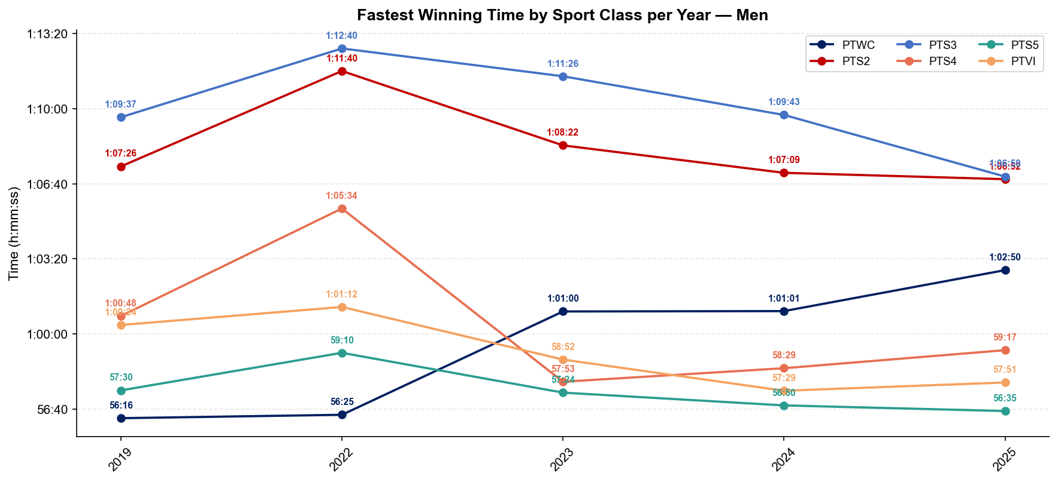
Winning Time Trends — Para Men
Montreal

Slide 13
PARA WOMEN

Slide 14
Para Series Results — Women
Montreal
Year | Date | PTWC | PTS2 | PTS3 | PTS4 | PTS5 | PTVI
2019 | Jun 28 | Tapp 1:07:25 | Seely 1:20:12 | Plotnikova 1:24:12 | Moore 1:11:30 | Cashmore 1:06:13 | Rodriguez 1:08:33
2022 | Jul 08 | Parker 1:05:08 | Danz 1:20:03 | — | Elmlinger 1:13:24 | Norman 1:05:45 | Rodriguez 1:07:24
2023 | Jul 08 | Parker 1:03:32 | Danz 1:14:40 | Vargas 1:28:01 | Elmlinger 1:13:26 | Norman 1:03:06 | Rodriguez 1:04:00
2024 | Jun 29 | Gretsch 1:05:34 | Seely 1:14:20 | Vargas 1:24:44 | Elmlinger 1:10:45 | Frenette 1:07:59 | Rodriguez 1:04:26
2025 | Jul 19 | Parker 1:03:08 | Francis 1:16:43 | Vargas 1:18:47 | Seneclauze 1:14:01 | Norman 1:02:03 | Freitas 1:05:47
World Para Series Women winners by sport class. Surname + winning total time. Years with no completed racing are omitted.

Slide 15
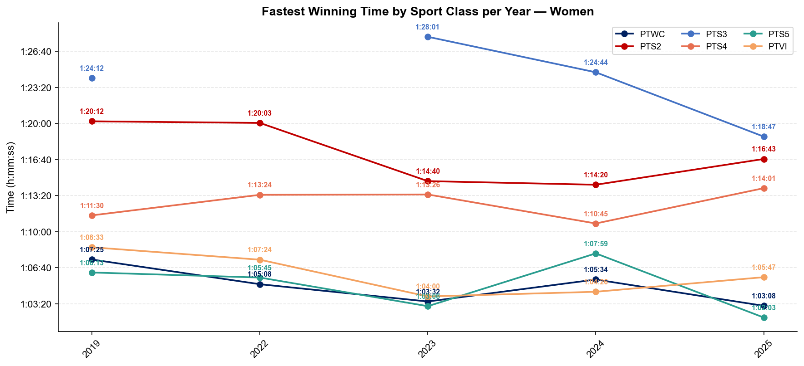
Winning Time Trends — Para Women
Montreal

Slide 16
Who to Watch — Montreal Race Week
ELITE MEN
ELITE WOMEN
Top 3 by World Ranking
Top 3 by World Ranking
Rank | Athlete | Points
1 | Matthew Hauser | 7,039
2 | Miguel Hidalgo | 6,539
3 | Henry Graf | 5,679
Rank | Athlete | Points
1 | Beth Potter | 7,299
2 | Lisa Tertsch | 6,704
3 | Jeanne Lehair | 6,059
Last Year's Podium at Montreal
Last Year's Podium at Montreal
1. Zach Leachman (00:52:20)
1. Erica Hawley (00:58:15)
2. Clayton Hutchins (00:52:22)
2. Maïra Carreau (00:58:22)
3. Liam Donnelly (00:52:25)
3. Anja Krueger (00:58:23)
Rankings = current World Triathlon rankings snapshot; startlist intersect uses program_entries when available.

